Slide 1
Top 6 web application vulnerability
1.Cross Site Scripting
Description
Cross Site Scripting is also shortly known as XSS.
XSS vulnerabilities target scripts embedded in a page that are executed on the client side i.e. user browser rather then at the server side. These flaws can occur when the application takes untrusted data and send it to the web browser without proper validation.
Attackers can use XSS to execute malicious scripts on the users in this case victim browsers. Since the browser cannot know if the script is trusty or not, the script will be executed, and the attacker can hijack session cookies, deface websites, or redirect the user to an unwanted and malicious websites.
XSS is an attack which allows the attacker to execute the scripts on the victim’s browser.
Implication:
Making the use of this security vulnerability, an attacker can inject scripts into the application, can steal session cookies, deface websites, and can run malware on the victim’s machines.
Vulnerable Objects
Input Fields
URLs

Slide 2
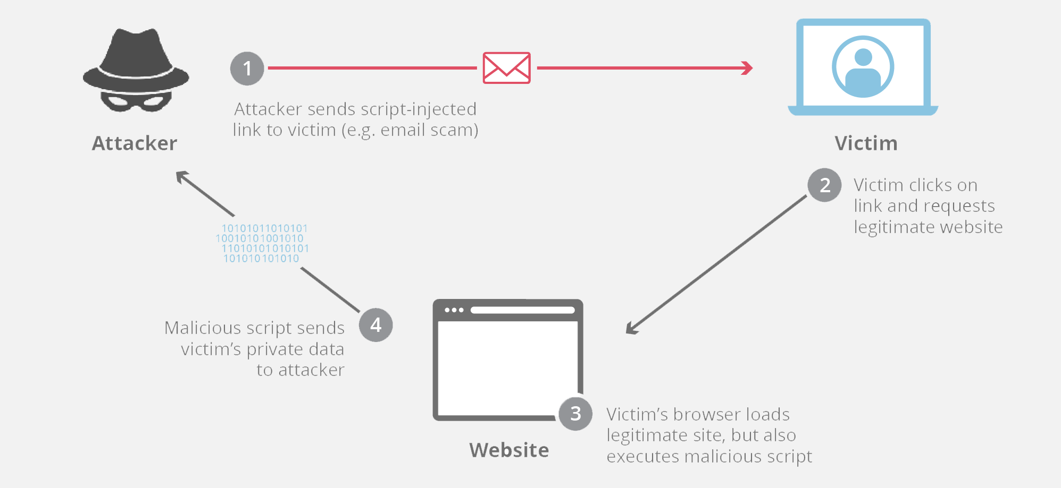

Slide 3
Types of cross site scripting
Reflected XSS (Non-Persistent or Type I)
Reflected XSS occurs when user input is immediately returned by a web application in an error message, search result, or any other response that includes some or all of the input provided by the user as part of the request, without that data being made safe to render in the browser, and without permanently storing the user provided data. In some cases, the user provided data may never even leave the browser
Stored XSS (AKA Persistent or Type II)
Stored XSS generally occurs when user input is stored on the target server, such as in a database, in a message forum, visitor log, comment field, etc. And then a victim is able to retrieve the stored data from the web application without that data being made safe to render in the browser. With the advent of HTML5, and other browser technologies, we can envision the attack payload being permanently stored in the victim’s browser, such as an HTML5 database, and never being sent to the server at all.
DOM-based XSS
DOM-based XSS is an advanced XSS attack. It is possible if the web application’s client-side scripts write data provided by the user to the Document Object Model (DOM). The data is subsequently read from the DOM by the web application and outputted to the browser. If the data is incorrectly handled, an attacker can inject a payload, which will be stored as part of the DOM and executed when the data is read back from the DOM.

Slide 4
labs for XXS:
https://portswigger.net/web-security/cross-site-scripting/reflected/lab-html-context-nothing-encoded
https://pentesterlab.com/exercises/xss_and_mysql_file/course

Slide 5
IODR
Insecure Direct Object References
Description
It occurs when a developer exposes a reference to an internal implementation object, such as a file, directory, or database key as in URL or as a FORM parameter. The attacker can use this information to access other objects and can create a future attack to access the unauthorized data.
Implication
Using this vulnerability, an attacker can gain access to unauthorized internal objects, can modify data or compromise the application.
Vulnerable Objects
In the URL.
Examples:
Changing “userid” in the following URL can make an attacker to view other user’s information.
http://www.vulnerablesite.com/userid=123 Modified to http://www.vulnerablesite.com/userid=124
An attacker can view others information by changing user id value.
Recommendations:
Implement access control checks.
Avoid exposing object references in URLs.
Verify authorization to all reference objects.

Slide 6
CSRF
Cross Site Request Forgery is a forged request came from the cross site.
CSRF attack is an attack that occurs when a malicious website, email, or program causes a user’s browser to perform an unwanted action on a trusted site for which the user is currently authenticated.
A CSRF attack forces a logged-on victim’s browser to send a forged HTTP request, including the victim’s session cookie and any other automatically included authentication information, to a vulnerable web application.
A link will be sent by the attacker to the victim when the user clicks on the URL when logged into the original website, the data will be stolen from the website.
Implication
Using this vulnerability as an attacker can change user profile information, change status, create a new user on admin behalf, etc.
Vulnerable Objects
User Profile page
User account forms
Business transaction page

Slide 7
SQL injection
SQL INJECTIONS
SQL injection is a type of web application security vulnerability in which an attacker attempts to use application code to access or corrupt database content. If successful, this allows the attacker to create, read, update, alter, or delete data stored in the back-end database. SQL injection is one of the most prevalent types of web application security vulnerabilities.

Slide 8
open redirect
An open redirect vulnerability occurs when an application allows a user to control a redirect or forward to another URL. If the app does not validate untrusted user input, an attacker could supply a URL that redirects an unsuspecting victim from a legitimate domain to an attacker's phishing site.

